Slide 1

Student Outpass System
A Java-based Outpass Management Application
D.TRILOK VARMA [RA2311026010137]
C.AJAY [RA2311026010128]
M.SUHAS GUPTHA [RA2311026010131]
N.MOHITH REDDY [RA2311026010132]

Slide 2
Abstract
This presentation covers the development of the Student Outpass System, a Java-based application designed to streamline the process of requesting and approving outpasses in educational institutions.
Objective: To digitize the outpass process, making it more efficient and easier to manage.
Key Features:
Student form submission for outpass requests.
Admin login and interface for request management.
Database storage and status tracking.
Technologies Used: Java (Swing for UI), SQLite database for persistent storage, SQL for data manipulation.

Slide 3
Problem Statement and Introduction
Problem Statement: The current manual process for handling student outpass requests is inefficient, time-consuming, and prone to errors, leading to delays and frustration.
Introduction: Institutions often face challenges managing large numbers of outpass requests. Manual processes lack a proper tracking mechanism, leading to issues like lost requests and delayed approvals.
Goal: Develop a digital system to simplify the outpass request and approval workflow, making it faster and more reliable.

Slide 4
Existing System
Current Manual Process:
Students fill out paper forms or send email requests, which are reviewed by administrative staff.
Admins manually approve or deny each request, which can be slow and inefficient.
Limitations of Existing System:
Paper forms are vulnerable to being lost or misplaced.
No easy tracking for request status.
Approval delays due to manual management.
Lack of an organized system for storing and managing past records.

Slide 5
Proposed Mode
Proposed Solution: A digital Student Outpass System that automates the request and approval process, providing an organized structure for outpass management.
Key Features of Proposed System:
User-friendly interfaces for both students and administrators.
Secure admin login with password protection.
Real-time database for storing and tracking requests.
Benefits: Faster processing, reduced paperwork, organized storage, and an easy-to-use interface.

Slide 6
System Architecture
System Components:
User Interface (UI): Swing-based UI for student request submission and admin request management.
Database: SQLite database to store request data, including student name, reason, date, days, and status.
Admin Logic: Admin functionality for viewing, approving, denying, and clearing requests.
Data Flow:
Students submit a form.
Data is sent to the database.
Admins log in, view requests, and update statuses.

Slide 7
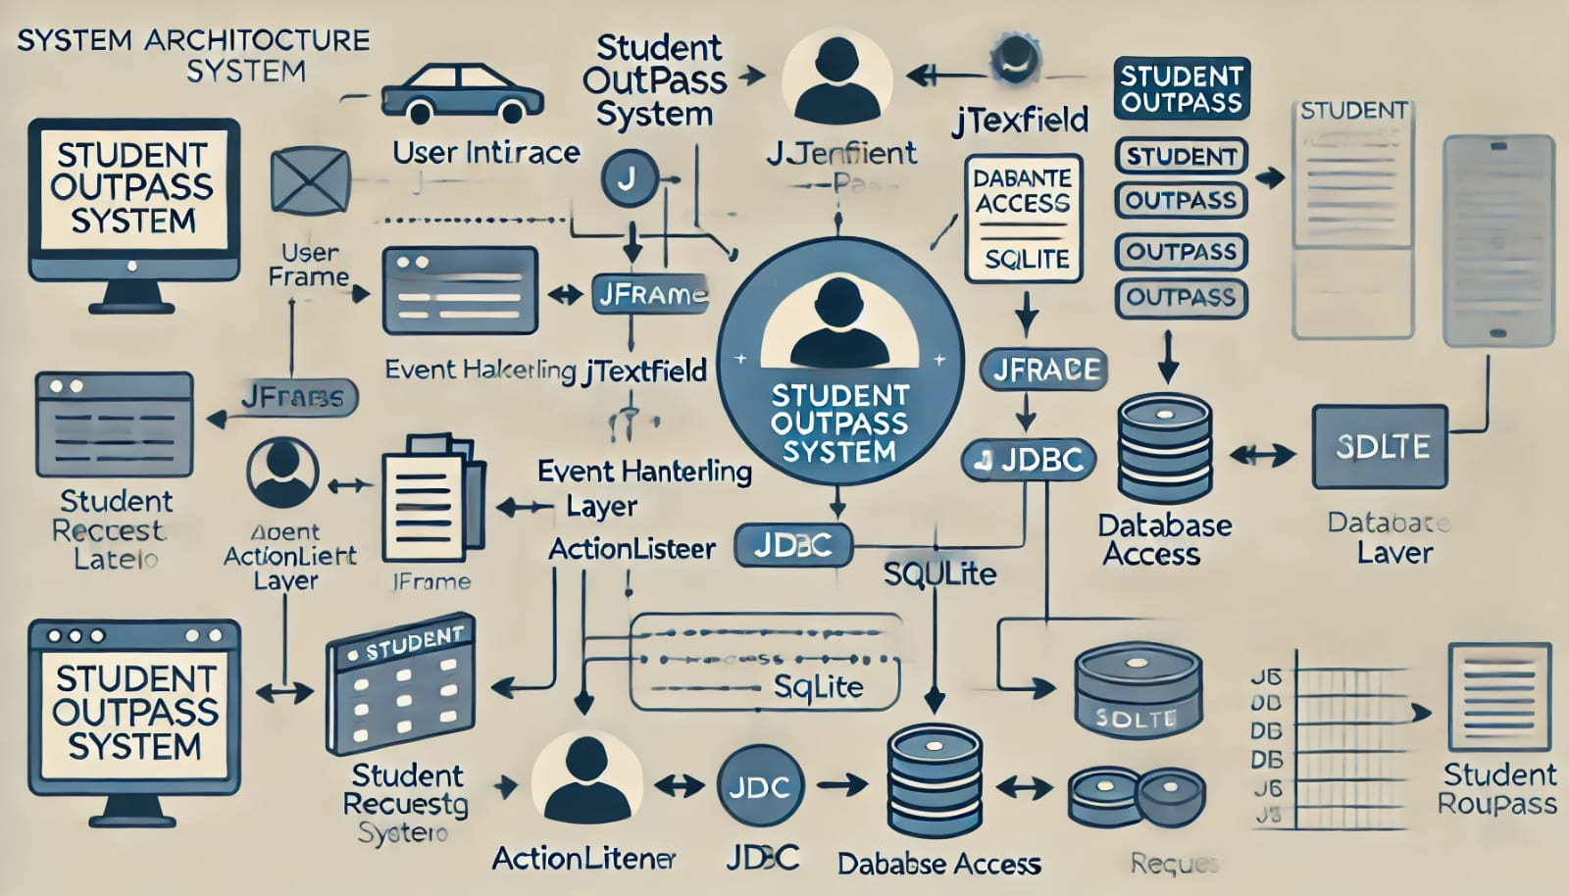
System Architecture

Slide 8
Modules in Proposed System
Student Module: Allows students to fill out a form with fields for name, reason, date, and number of days. Validates input before submission.
Admin Module: Provides an admin interface to view all submitted requests, accept or deny requests, and clear all requests.
Database Module: Manages data storage for outpass requests, updates statuses, and removes records as needed.

Slide 9
Software Specifications
Database: SQLite, chosen for its simplicity and lightweight nature.
Development Environment: Developed and tested in Eclipse/IntelliJ.
Libraries Used:
javax.swing for the graphical user interface.
java.sql for database connectivity.
java.awt for UI layout and design.
Operating System Compatibility: Cross-platform (Windows, Linux, and Mac).
Programming Language: Java, with Swing for the user interface.

Slide 10
Detailed Implementation of Key Features
Student Form Submission
Students access the system and fill out a form containing:
Name, Reason for Outpass, Date (in YYYY-MM-DD format), and Number of Days.
Validation:
Checks that all fields are filled.
Verifies date format and positive integer for days.
Submission: Data is submitted and stored in the database as a new request with "Pending" status.
.

Slide 11
Detailed Implementation of Key Features
Admin Login & Interface
Admin Login: Admins are prompted for a password to access the system. Incorrect entries return to the home screen.
Admin Interface: Once logged in, admins can:
View all pending requests.
Accept or deny requests, updating the database.
Clear all requests if necessary.
.

Slide 12
Detailed Implementation of Key Features
Database Interaction
Database Operations: Data is stored, updated, and deleted using SQL commands.
Inserting new requests with a status of "Pending".
Updating request status to "Accepted" or "Denied".
Deleting all requests when clearing the database.
.
.

Slide 13
UI Design and Flow
Home Screen: Two options – Student and Admin.
Student Form: Text fields for user input, submit button to save the request.
Admin Login: Password entry for secure access.
Admin Interface: Text area to view all requests, and buttons to approve, deny, or clear.
Flow: Show a diagram for how users navigate through these screens.

Slide 14
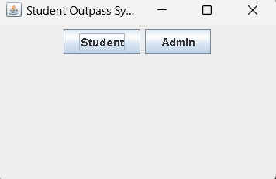
Results / Screenshots
HOME SCREEN

Slide 15
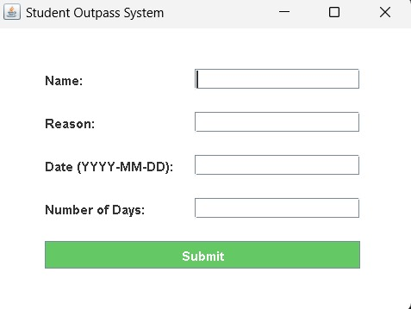
Results / Screenshots
STUDENT FORM SUBMISSION

Slide 16
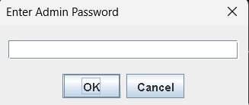
Results / Screenshots
ADMIN LOGIN PROMPT

Slide 17
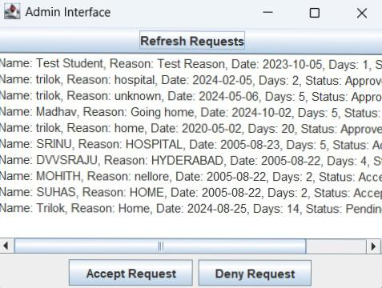
Results / Screenshots
ADMIN INTERFACE

Slide 18
Conclusion
Summary of Key Points:
Successfully developed a digital outpass management system.
Simplified the submission and approval process.
Provided a secure admin interface and organized tracking.
Impact: Enhanced efficiency, better tracking, reduced paperwork, and a streamlined experience for both students and admins.

Slide 19
Future Enhancements
Possible Improvements:
>Implement email notifications to notify students of request status changes.
>Introduce login profiles for both students and admins with unique credentials.
>Advanced request filtering options for the admin to easily find specific requests.
>Upgrade database to MySQL or PostgreSQL for scalability in larger institutions.

Slide 20
THANK YOU

